Slide 1
Predicting Stock Prices Using Big-Data Tools and Deep Learning
Presentation By:
Rajan Bajaj

Slide 2
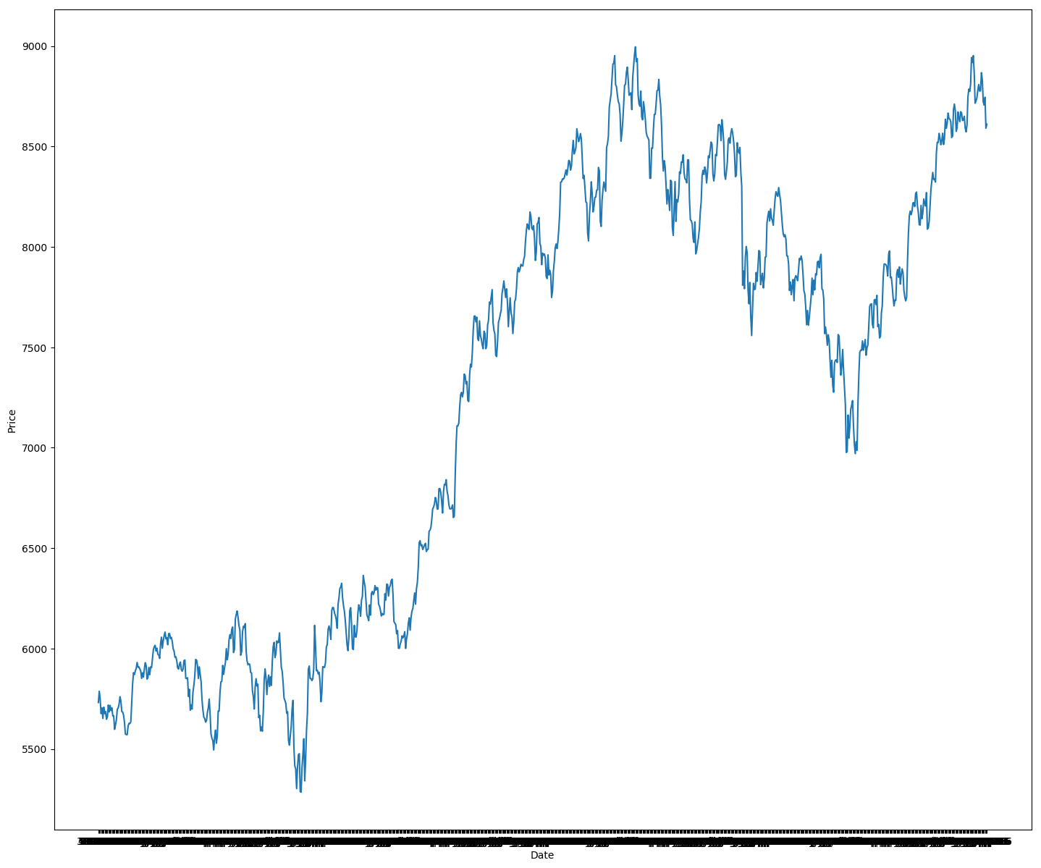
Proposition
Prediction of rise and fall of stock prices is very difficult task for many analysts and researches.
Investors and traders looks for better prediction methods.
In this project a combined technique of Big Data and Deep Learning is used to get fast and accurate prediction on Nifty 50 Data.
Recurrent neural networks(RNN) and Long Short-Term Memory(LSTM) approach which are part of Deep Learning field and to increase the training rate the process of training will be distributed on a cluster of computers using Apache Spark.
Nifty 50 Daily Closing Price Data

Slide 3
Introduction
The temporal relation of historical data to future values prediction is found using a Long Short-term Memory approach. The data is divided in data-frames and fed to the model for training it in batches.
Training Deep Neural network is time consuming process. For this reason taking advantage of cluster to speed up training is important area of work.
For much difficult problems such as computation on ImageNet dataset training can take much longer time on a single GPU and hence we can take advantage of Distributed platform for training Deep Learning models.
Apache Spark for data parallelization as well as model parallelization is used.
Model parallelization is partitioning network over different machines.

Slide 4
Advantages
Fast and scalable training and prediction which is very important in stock market analysis for optimization of profit.
GPUs are not required for heavy computation as model is also distributed over many machines.
Low cost approach.

Slide 5
Different Works
DistBelief from Google
Elephas: Distributed Deep Learning with Keras & Spark*
Project Adams from Microsoft
are both distributed frameworks meant for training large scale models for deep networks over thousands of machines and utilizing both data and model parallelism.

Slide 6
Elephas: Distributed Deep Learning with Keras & Spark
This framework provides:
Data-Parallel training of deep learning models
Distributed hyper-parameter optimization
Distributed training of ensemble models
Basic Spark Integration using pyspark
Spark MLlib Integration

Slide 7
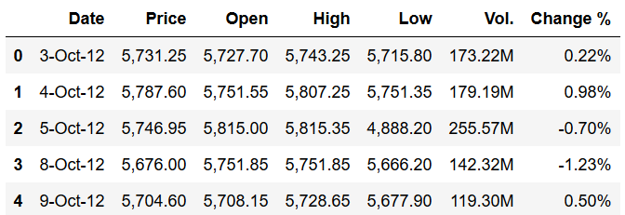
Nifty 50 Dataset
Sample Data:

Slide 8
Nifty 50 Dataset
Fig: Historical data of Nifty 50 of past 7 years.

Slide 9
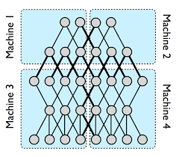
Previously Proposed Methodology
Downpour SGD:
provides asynchronous and distributed implementation of stochastic gradient descent.
The training instances are divided across different machines (Data Parallelism).
Model Parallelism:
For large deep learning neural network the model layers itself can distributed across as different machines. This will speed up the training process on CPUs and requirement of GPUs are reduced.
Model Parallelization

Slide 10
Final Methodology

Slide 11
LSTM Training
LSTM stands for Long Short-Term Memory, and it is artificial recurrent neural network (RNN) architecture.
The difference between feed-forward neural networks and LSTM is that LSTM has a feedback loop to previous layers which helps in prediction using history data and present data.
A common LSTM cell has an input gate, an output gate and a forget gate. So the cell remembers the information for some time interval and the gates controls the inflow and outflow of the information.
LSTMs are used to make temporal inferences on historical data.
This Network can be updated on daily basis for new data an it is called Rolling Window.
This LSTM Model will be distributed as explained in Methodology above.

Slide 12
Parameters To be used for training
Daily closing price of stock.
High/Low prices of stock.
High/Open/Low prices of stock.
High/Open/Close/Low prices of stock.

Slide 13
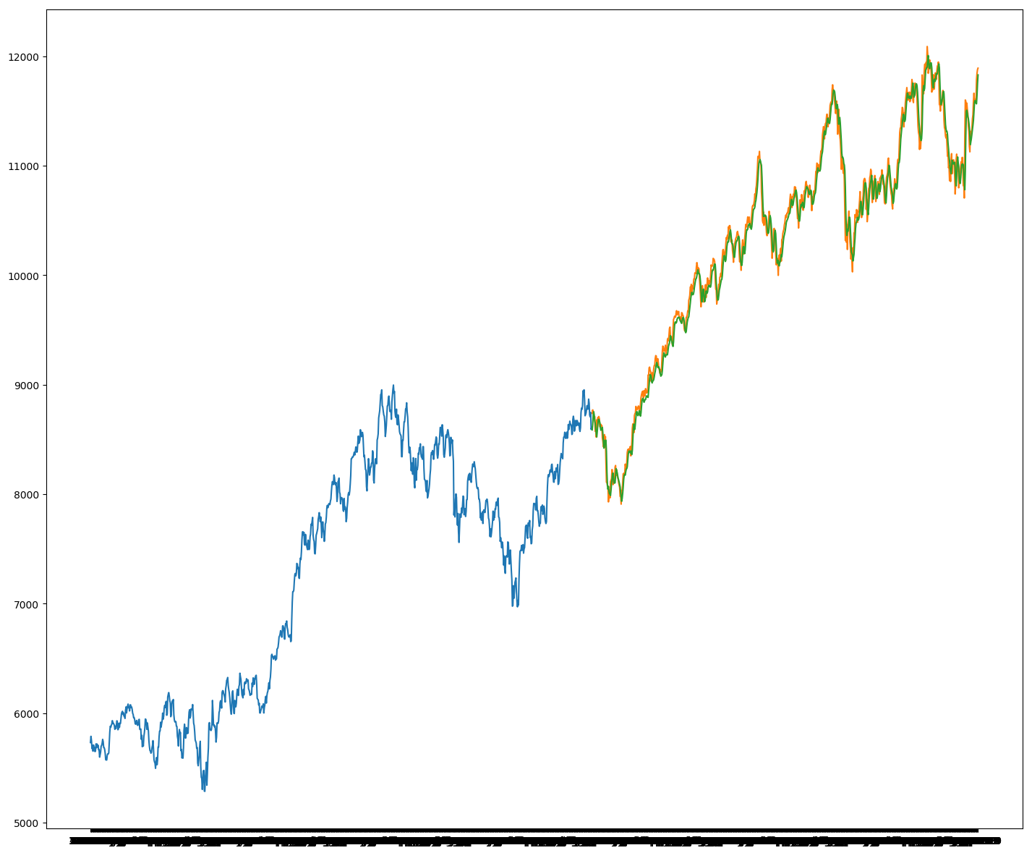
Inference Training
The Figure shown to the right is LSTM training data in blue validation data in yellow and prediction on validation data in green. For 500 epochs of training it and approximately 1700 data points it took 500 seconds to train and validate data. So the goal of this project is to Predict accurately and efficiently using distributed training. So in future large models can be built using the same technique and help in decreasing training time.

Slide 14
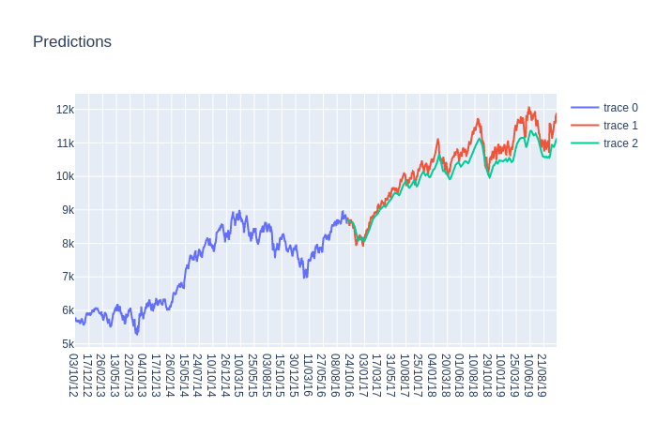
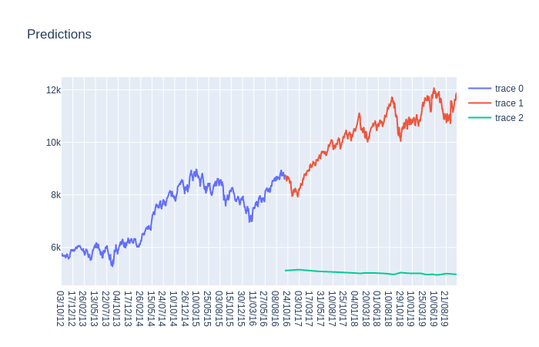
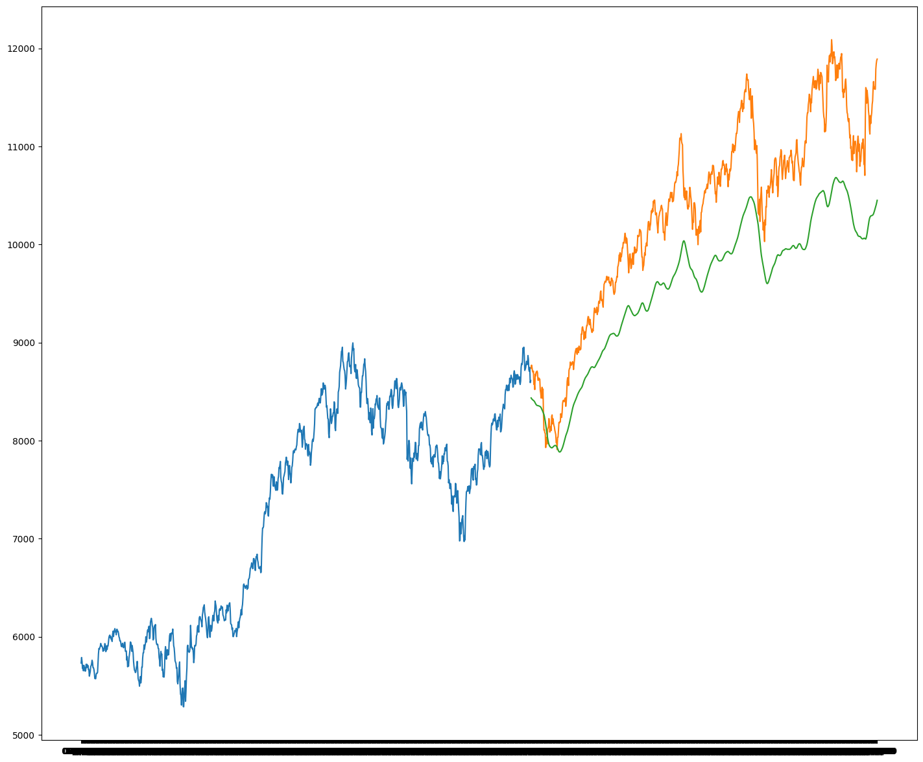
Inference Training
Distributed LSTM Model
Statistical Model
Non- Distributed LSTM Model

Slide 15
Challenges:
Main Challenge here is the distribution of model. There are some frameworks in spark for distribution of model. Two of them are BigDL and Elephas.
Another challenge is how the data can be handled asynchronously. This can be handled using Downpour SGD.
Identifying the right parameters for the prediction of stock prices.
Initially I was working on Windows 10 for creating the model but found it difficult to combine the discrete components such as LSTM, pyspark and jupyter notebook. So I switched to Linux platform and till now installed apache spark, hadoop, jupyter notebook, pyspark and elephas.

Slide 16
References:
Dean, Jeffrey, et al. "Large scale distributed deep networks." Advances in neural information processing systems. 2012.
Shrivastava, Disha, Santanu Chaudhury, and Dr Jayadeva. "A data and model-parallel, distributed and scalable framework for training of deep networks in apache spark." arXiv preprint arXiv:1708.05840 (2017).
https://software.intel.com/en-us/articles/bigdl-distributed-deep-learning-on-apache-spark
J. Dean, G.S. Corrado, R. Monga, K. Chen, M. Devin, QV. Le, MZ. Mao, M’A. Ranzato, A. Senior, P. Tucker, K. Yang, and AY. Ng. Large Scale Distributed Deep Networks.
https://github.com/cerndb/dist-keras?source=post_page-----6d397c16abd----------------------
https://github.com/maxpumperla/elephas?source=post_page-----6d397c16abd----------------------

Slide 17
Code Snippets for Spark and Keras Integration
Create local pyspark context
from pyspark import SparkContext, SparkConf
conf = SparkConf().setAppName('Elephas_App').setMaster('local[8]')
sc = SparkContext(conf=conf)
from keras.models import Sequential
from keras.layers.core import Dense, Dropout, Activation
from keras.optimizers import SGD
model = Sequential()
model.add(Dense(128, input_dim=784))
model.add(Activation('relu'))
model.add(Dropout(0.2))
model.add(Dense(128))
model.add(Activation('relu'))
model.add(Dropout(0.2))
model.add(Dense(10))
model.add(Activation('softmax'))
model.compile(loss='categorical_crossentropy', optimizer=SGD())
Define keras Model
from elephas.utils.rdd_utils import to_simple_rdd
rdd = to_simple_rdd(sc, x_train, y_train)
Create RDD from numpy arrays
from elephas.spark_model import SparkModel
spark_model = SparkModel(model, frequency='epoch', mode='asynchronous')
spark_model.fit(rdd, epochs=20, batch_size=32, verbose=0, validation_split=0.1)
Run Script using:
$ spark-submit --driver-memory 1G ./your_script.py

